Slide 1

Chapter 18 Applets and Multimedia

Slide 2
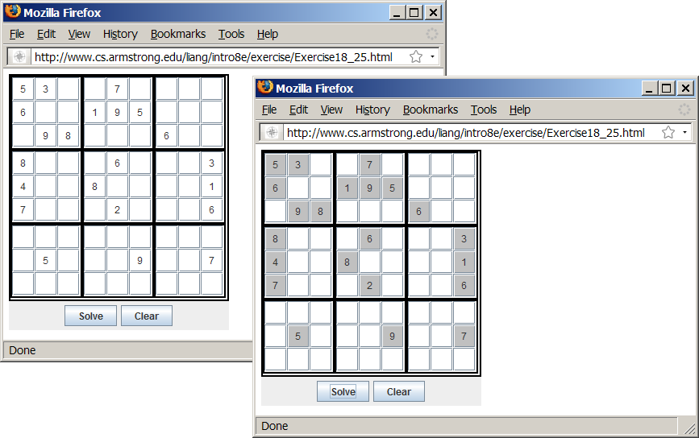
Motivations
When browsing the Web, you frequently see the graphical user interface and animation developed using Java. These programs are called Java applets. Suppose you want to develop a Java applet for the Sudoku game. How do you write this program?
Sudoku

Slide 3
Objectives
To convert GUI applications to applets (§18.2).
To embed applets in Web pages (§18.3).
To run applets from Web browsers and from the appletviewer (§§18.3.1-18.3.2).
To write a Java program that can run as both an application and an applet (§18.4).
To override the init, start, stop, and destroy methods in the Applet class (§18.5).
To pass string values to applets from HTML (§18.6).
To develop an applet for the TicTacToe game (§18.7).
To develop an animation for a bouncing ball (§18.8).
To locate resources (images and audio) using the URL class (§18.9).
To play audio in any Java program (§18.10).

Slide 4
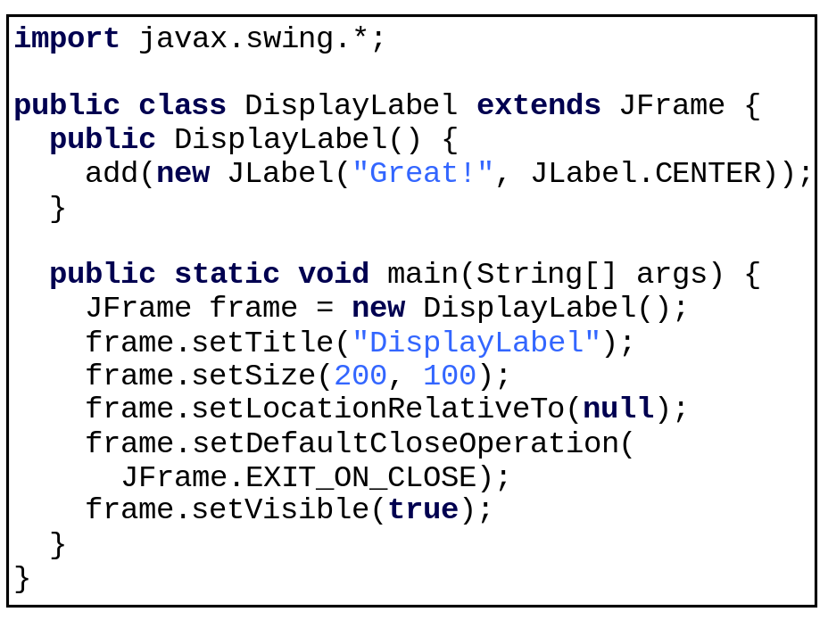
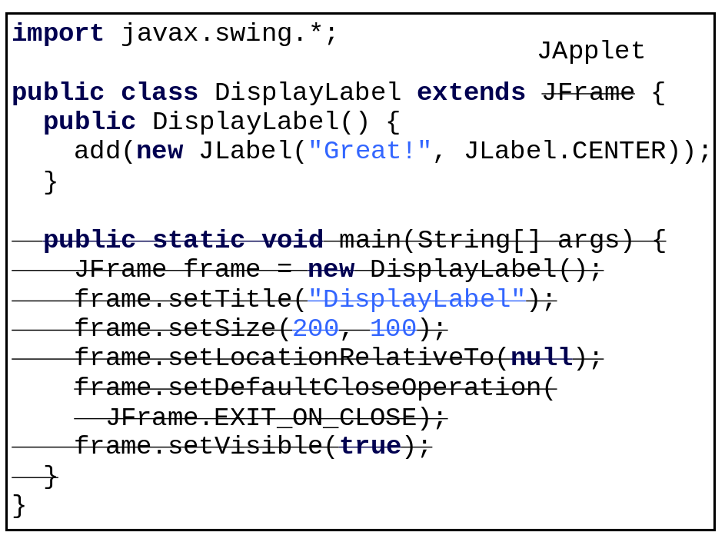
Developing Applets

Slide 5
The <applet> HTML Tag
<applet
code=classfilename.class
width=applet_viewing_width_in_pixels
height=applet_viewing_height_in_pixels
[archive=archivefile]
[codebase=applet_url]
[vspace=vertical_margin]
[hspace=horizontal_margin]
[align=applet_alignment]
[alt=alternative_text]
>
<param name=param_name1
value=param_value1>
</applet>

Slide 6
First Simple Applet
<html>
<head>
<title>Java Applet Demo</title>
</head>
<body>
<applet
code = "DisplayLabel.class"
width = 350
height = 200>
</applet>
</body>
</html>
DisplayLabel
Run Applet Viewer

Slide 7
Applications vs. Applets
Similarities
  Since JFrame and JApplet both are subclasses of the Container class, all the user interface components, layout managers, and event-handling features are the same for both classes.
Differences
  Applications are invoked from the static main method by the Java interpreter, and applets are run by the Web browser. The Web browser creates an instance of the applet using the applet’s no-arg constructor and controls and executes the applet through the init, start, stop, and destroy methods.
  Applets have security restrictions
  Web browser creates graphical environment for applets, GUI applications are placed in a frame.

Slide 8
Security Restrictions on Applets
Applets are not allowed to read from, or write to, the file system of the computer viewing the applets.
Applets are not allowed to run any programs on the browser’s computer.
Applets are not allowed to establish connections between the user’s computer and another computer except with the server where
the applets are stored.

Slide 9
Conversions Between Applications and Applets
Conversions between applications and applets are simple and easy.
You can always convert an applet into an application.
You can convert an application to an
applet as long as security restrictions are
not violated.

Slide 10
Enabling Applets to Run as Applications
import javax.swing.*;
public class DisplayLabel extends JApplet {
public DisplayLabel() {
add(new JLabel("Great!", JLabel.CENTER));
}
public static void main(String[] args) {
// Create a frame
JFrame frame = new JFrame("Applet is in the frame");
// Create an instance of the applet
DisplayLabel applet = new DisplayLabel();
// Add the applet to the frame
frame.add(applet);
// Display the frame
frame.setSize(300, 100);
frame.setLocationRelativeTo(null); // Center the frame
frame.setDefaultCloseOperation(JFrame.EXIT_ON_CLOSE);
frame.setVisible(true);
}
}

Slide 11
The Applet Class
When the applet is loaded, the Web browser creates an instance of the applet by invoking the applet’s no-arg constructor. The browser uses the init, start, stop, and destroy methods to control the applet. By default, these methods do nothing. To perform specific functions, they need to be modified in the user's applet so that the browser can call your code properly.

Slide 12
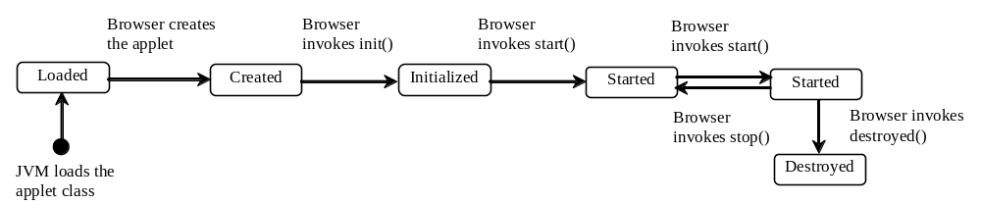
Browser Calling Applet Methods

Slide 13
The init() Method
Invoked when the applet is first loaded and again if the applet is reloaded.
A subclass of Applet should override this method if the subclass has an initialization to perform. The functions usually implemented in this method include creating new threads, loading images, setting up user-interface components, and getting string parameter values from the <applet> tag in the HTML page.

Slide 14
The start() Method
Invoked after the init() method is executed; also called whenever the applet becomes active again after a period of inactivity (for example, when the user returns to the page containing the applet after surfing other Web pages).
A subclass of Applet overrides this method if it has any operation that needs to be performed whenever the Web page containing the applet is visited. An applet with animation, for example, might use the start method to resume animation.

Slide 15
The stop() Method
The opposite of the start() method, which is called when the user moves back to the page containing the applet; the stop() method is invoked when the user moves off the page.
A subclass of Applet overrides this method if it has any operation that needs to be performed each time the Web page containing the applet is no longer visible. When the user leaves the page, any threads the applet has started but not completed will continue to run. You should override the stop method to suspend the running threads so that the applet does not take up system resources when it is inactive.

Slide 16
The destroy() Method
Invoked when the browser exits normally to inform the applet that it is no longer needed and that it should release any resources it has allocated.
A subclass of Applet overrides this method if it has any operation that needs to be performed before it is destroyed. Usually, you won't need to override this method unless you wish to release specific resources, such as threads that the applet created.

Slide 17
Writing Applets
Always extends the JApplet class, which is a subclass of Applet for Swing components.
Override init(), start(), stop(), and destroy() if necessary. By default, these methods are empty.
Add your own methods and data if necessary.
Applets are always embedded in an
HTML page.

Slide 18
Passing Parameters to Applets
<applet
code = "DisplayMessage.class"
width = 200
height = 50>
<param name=MESSAGE value="Welcome
to Java">
<param name=X value=20>
<param name=Y value=20>
alt="You must have a Java-enabled browser to view the applet"
</applet>

Slide 19
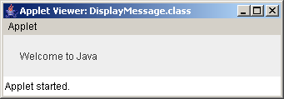
Example: Passing Parameters to Java Applets
Objective: Display a message at a specified location. The message and the location (x, y) are obtained from the HTML source.
DisplayMessage
Run Applet Viewer

Slide 20
Example: Running a Program as an Applet and as an Application
Objective: Modify MessageApplet to enable it to run both as an applet and as an application.
DisplayMessageApp
Run as Application
Run as Applet

Slide 21
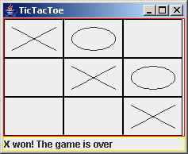
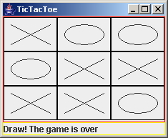
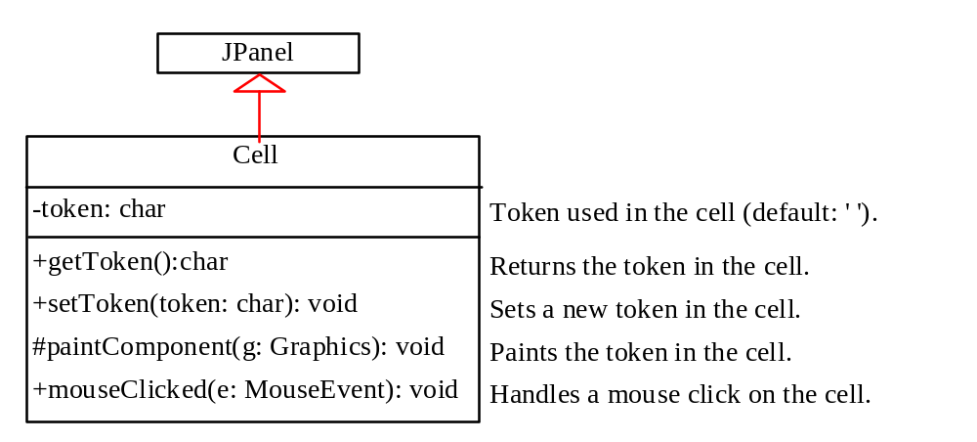
Case Study: TicTacToe

Slide 22
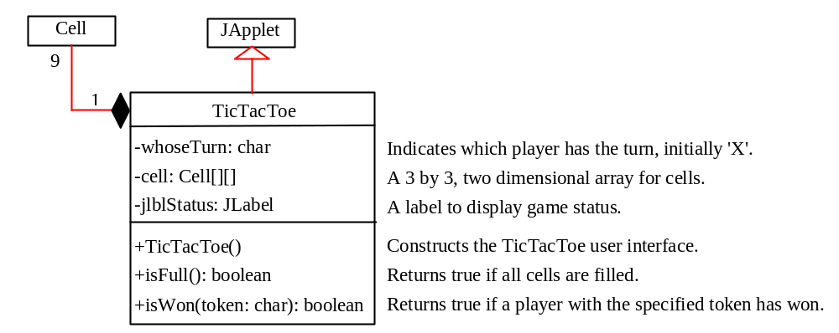
Case Study: TicTacToe, cont.
TicTacToe
Run as Application
Run as Applet

Slide 23
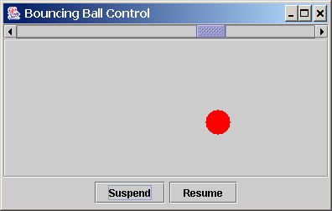
Case Study: Bouncing Ball
Objective: Write an applet that displays a ball bouncing in a panel. Use two buttons to suspend and resume the movement and use a scroll bar to control the bouncing speed.

Slide 24
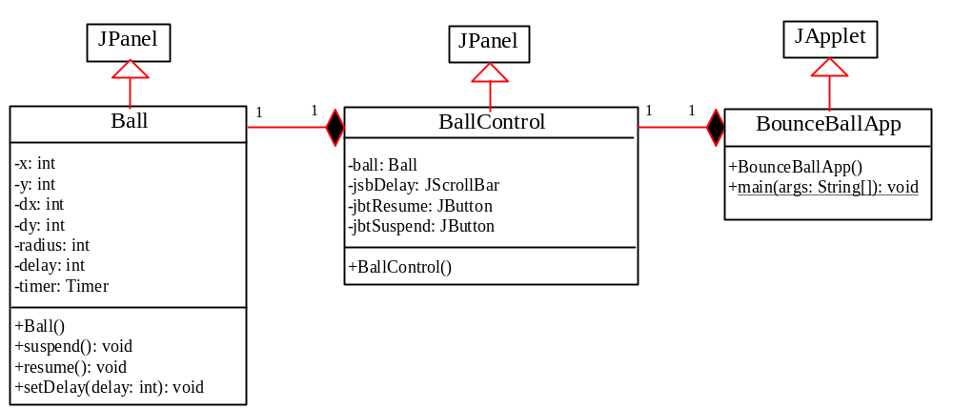
Case Study: Bouncing Ball, cont.
Ball
BallControl
BounceBallApp
Run

Slide 25
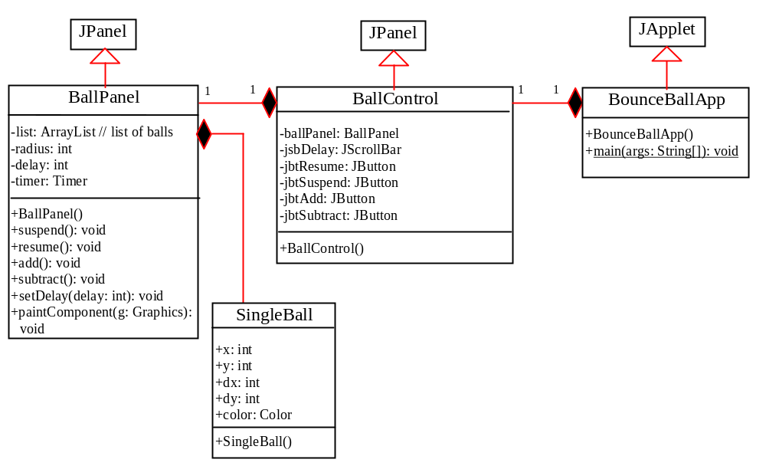
Exercise for extending to multiple balls

Slide 26
Locating Resource from Applets
Due to security restrictions, applets cannot access local files. How can an applet load resource files for image and audio?

Slide 27
Creating ImageIcon Using Absolute File Names
Example:
  ImageIcon imageIcon = new ImageIcon("c:\\book\\image\\us.gif");
  jlbl.setIcon(imageIcon);
This approach suffers a problem. The file location is fixed since it uses the absolute file path on Window. Thus, the program cannot run on other platforms and cannot run as applet.

Slide 28
Creating ImageIcon Using Relative File Names
Assume that image/us.gif is under the class directory, you can circumvent this problem by using a relative path as follows:
  ImageIcon imageIcon = new ImageIcon("image/us.gif");
  jlbl.setIcon(imageIcon);
This works fine with Java applications on all platforms, but does not work with Java applets because applets cannot load local files. To make it to work with both applications and applets, you need to locate the file using the URL class.

Slide 29
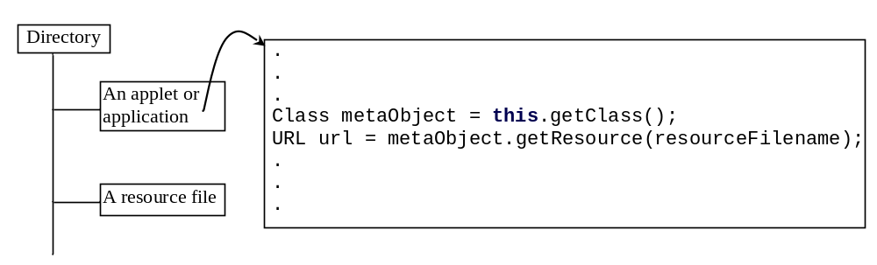
Locating Resource Using the URL Class
The java.net.URL class can be used to identify files (image, audio, text, etc.) on the Internet. In general, a URL (Uniform Resource Locator) is a pointer to a “resource” on the World Wide Web on a local machine or a remote host. A resource can be something as simple as a file or a directory.

Slide 30
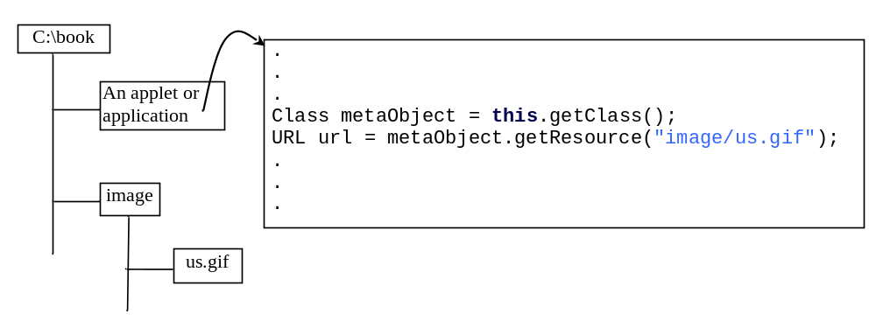
Creating a URL from a Class Reference
A URL for a file can also be accessed from a class in a way that is independent of the location of the file, as long as the resource file is located in the class directory.

Slide 31
Displaying Image
Write a program that displays an image from /image/us.gif in the class directory on a panel.
DisplayImageWithURL
Run

Slide 32
Creating AudioClip from an Audio File
To play an audio file in an applet, first create an audio clip object for the audio file. The audio clip is created once and can be played repeatedly without reloading the file. To create an audio clip, use the static method newAudioClip() in the java.applet.Applet class:
  AudioClip audioClip = Applet.newAudioClip(url);
Audio was originally used with Java applets. For this reason, the AudioClip interface is in the java.applet package.
The following statements, for example, create an AudioClip for the beep.au audio file in the same directory with the class you are running.
  Class class = this.getClass();
  URL url = class.getResource("beep.au");
  AudioClip audioClip = Applet.newAudioClip(url);

Slide 33
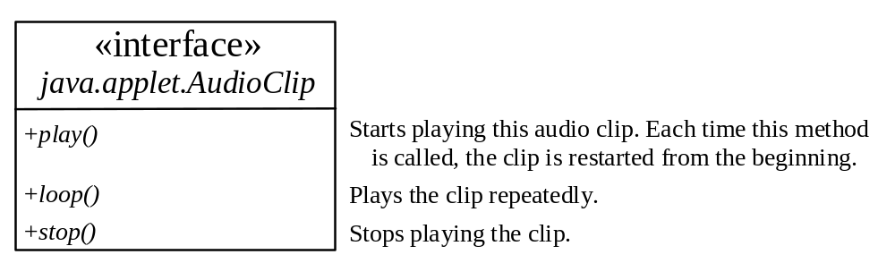
Playing Audio
To manipulate a sound for an audio clip, use the play(), loop(), and stop() methods in java.applet.AudioClip.
DisplayImagePlayAudio
Run

Slide 34
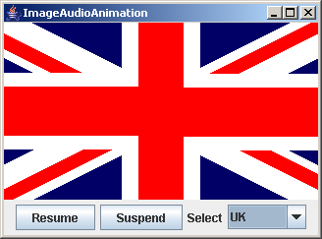
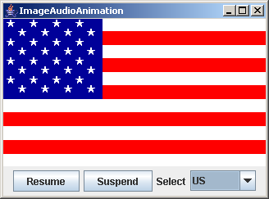
Multimedia Animation
ImageAudioAnimation
Run as an Application

Slide 35
Packaging and Deploying
Java Projects
Companion Website
What is JAR?
Java archive file can be used to group all the project files in a compressed file for deployment.
The Java archive file format (JAR) is based on the popular ZIP file format.
This single file can be deployed on an end-user’s machine as an application. It also can be downloaded to a browser in a single HTTP transaction, rather than opening a new connection for each piece. This greatly simplifies application deployment and improves the speed with which an applet can be loaded onto a web page and begin functioning.

Slide 36
Creating JAR
Companion Website
You can use the JDK jar command to create an archive file. The following command creates an archive file named TicTacToe.jar for classes TicTacToe.class and TicTacToe$Cell.class.
    jar -cf TicTacToe.jar TicTacToe.class TicTacToe$Cell.class
The -c option is for creating a new archive file, and the -f option specifies the archive file’s name.

Slide 37
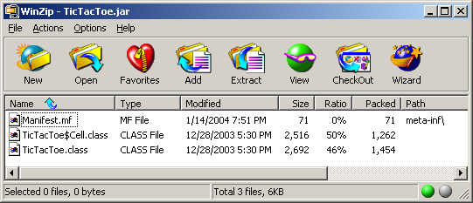
Viewing the Contents of a JAR File
Companion Website
You can view the contents of a .jar file using WinZip.

Slide 38
Manifest File
Companion Website
A manifest file was created with the path name meta-inf\. The manifest is a special file that contains information about the files packaged in a JAR file. For instance, the manifest file in TicTacToe.jar contains the following information:
  Manifest-Version: 1.0
  Name: TicTacToe.class
  Java-Bean: True
  Name: TioTacToe$Cell.class
  Java-Bean: True
You can modify the information contained in the manifest file to enable the JAR file to be used for a variety of purposes. For instance, you can add information to specify a main class to run an application using the .jar file.

Slide 39
Running Archived Projects Standalone
Companion Website
The manifest file must have an entry to contain the main class. For example, to run TicTacToe, you need to insert the following two lines in the manifest file:
  Main-Class: TicTacToe
  Sealed: true
Run the .jar file using the java command from the directory that contains TicTacToe.jar,
  java -jar TicTacToe.jar
TIP: You can write an installation procedure that creates the necessary directories and subdirectories on the end-user’s computer. The installation can also create an icon that the end-user can double-click on to start the program. For information on creating Windows desktop icon, please see www.prenhall.com/liang/intro5e.html.

Slide 40
Running Archived Projects As Applet
Companion Website
To run TicTacToe as an applet, modify the <APPLET> tag in the HTML file to include an ARCHIVE attribute. The ARCHIVE attribute specifies the archive file in which the applet is contained. For example, the HTML file for running TicTacToe can be modified as shown below:
    <APPLET
    CODE = "TicTacToe.class"
    ARCHIVE = "TicTacToe.jar"
    WIDTH = 400
    HEIGHT = 300
    HSPACE = 0
    VSPACE = 0
    ALIGN = Middle
    >
    </APPLET>

